Slide 1

Submitted to: Submitted by:
Dr. Manish Kumar Mukhija Mohit Kumar Sharma
(Head of Department) (VII Sem CSE Roll No.:18EAICS090)
Department of Computer Science Branch
Arya Institute of Engineering & Technology
SP-40 A, RIICO Industrial Area, Delhi Road, Kukas, Jaipur, Rajasthan 302028
Session [2018-2022]

Slide 2
CORE JAVA PROGRAMMING

Slide 3
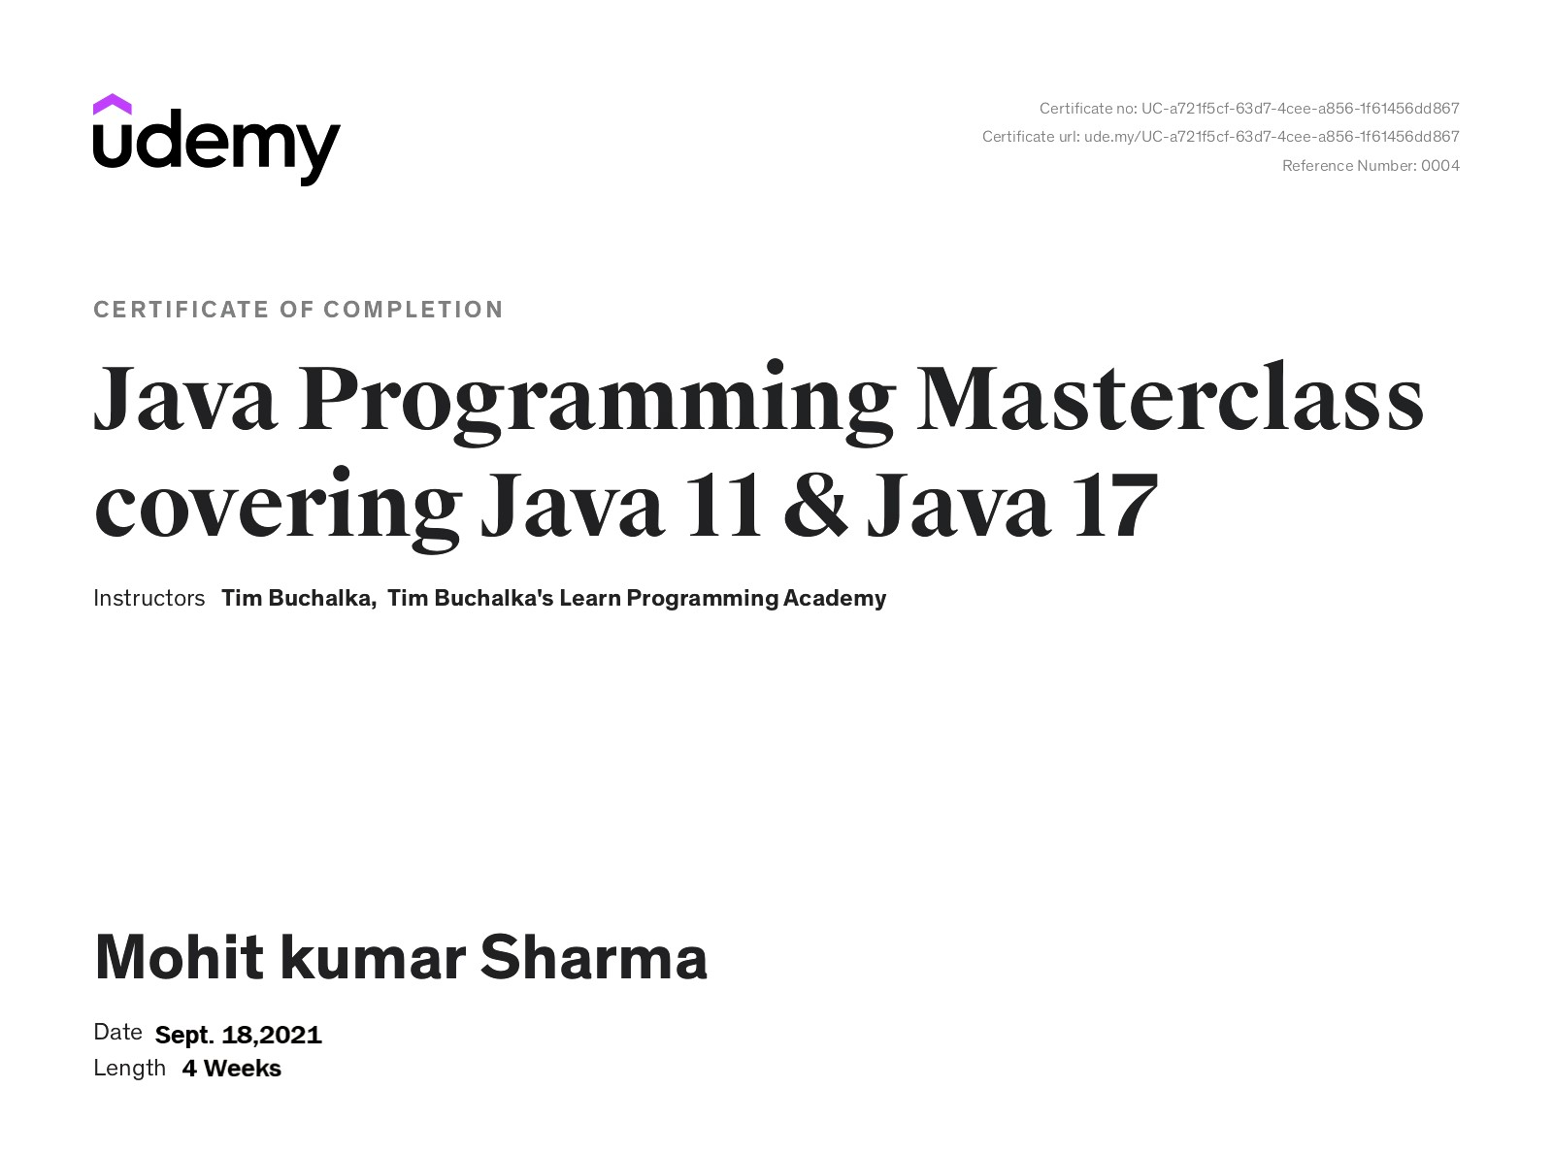

Slide 4
Introduction core java :
Java is the same as C and C++. One major difference is that Java does not have pointers.
The biggest difference is that you must write object oriented code in Java.
Java also has standard libraries for doing mathematics.
In Java we distinguish between applications, which are programs that perform the same functions as those written in other programming languages, and applets, which are programs that can be embedded in a Web page and accessed over the Internet.

Slide 5
Object oriented programing in java :
Abstraction
Polymorphism
Method Overloading
Method Overriding
Inheritance
Encapsulation
Object class and its methods
Primitive wrappers for parse methods
Constructors and constructor chaining
Static and object initializer blocks
Garbage Collection and Memory management
Inner classes
Important concepts in Java :

Slide 6
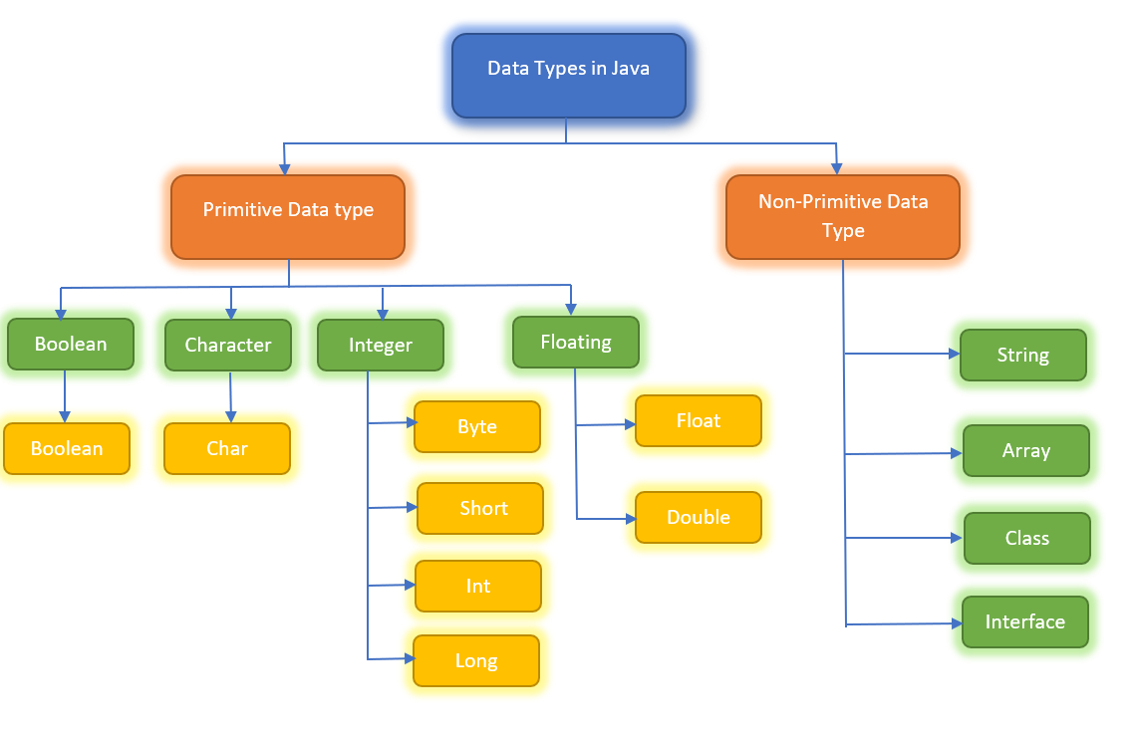

Slide 7
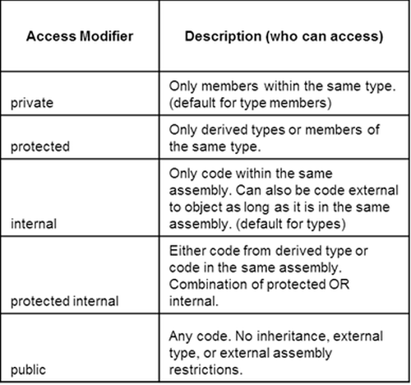

Slide 8
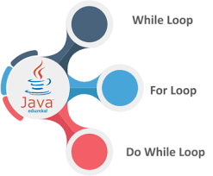

Slide 9




Slide 10
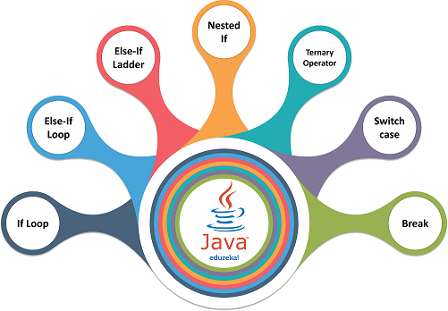


Slide 11
Exception handling :
Basics of Exception(checked and unchecked exceptions)
Handling the Exceptions, Try-catch, final blocks
Creating your own exceptions
Propagating uncaught exceptions, Exception hierarchy
Common and exception and errors
Overriding hashcode() and equals()
Collection interfaces and classes
Using the collection frame work
Generics and legacy code
Polymorphism and generics
Data structures Collections and Generics :

Slide 12
Salient Features of core Java :
80% hands on / practical classes.
Real time Scenarios / Project Exposure.
Placement Assistance which includes
Resume Preparation
Individual Counselling
Offline Support, which includes email queries and
assignments.
4. Association with people who are working for more than 20 Companies who may provide interviews .

Slide 13
Advantages of Java
1. Java is easy to learn.
2. Java is object-oriented.
3. Java is secure.
4. Java is platform-independent.
5. Java is distributed.

Slide 14
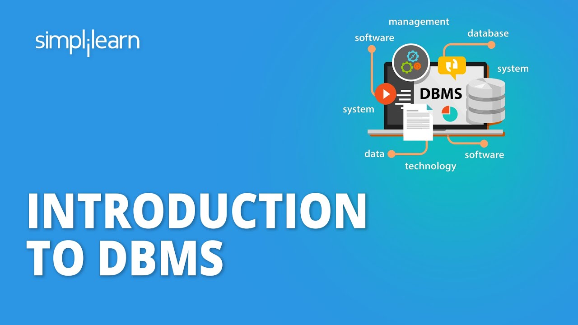

Slide 15


Database is a collection of inter-related data which helps in efficient retrieval, insertion and deletion of data from database and organizes the data in the form of tables, views, schemas, reports etc.
For Example : - University database organizes the data about students, faculty, and admin staff etc. which helps in efficient retrieval, insertion and deletion of data from it.

Slide 16
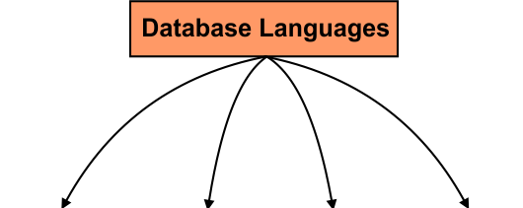






Slide 17
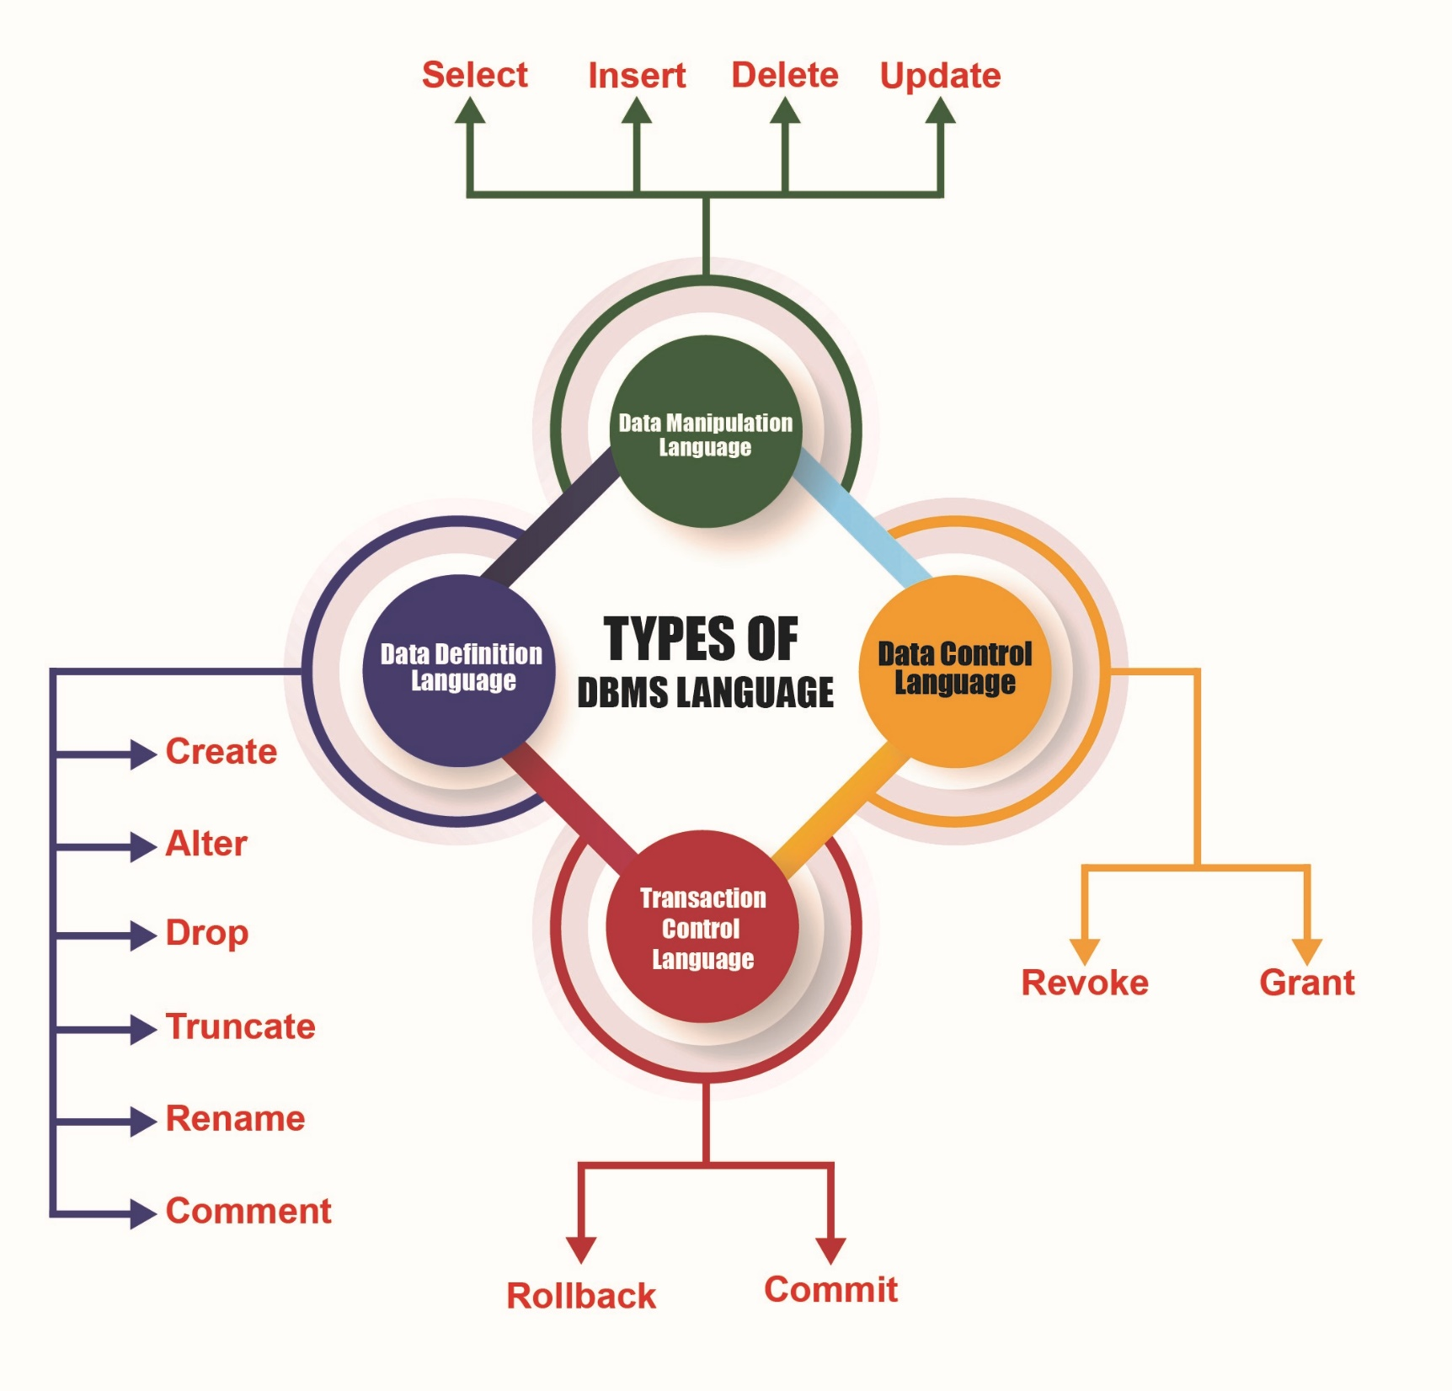

Slide 18




Slide 19
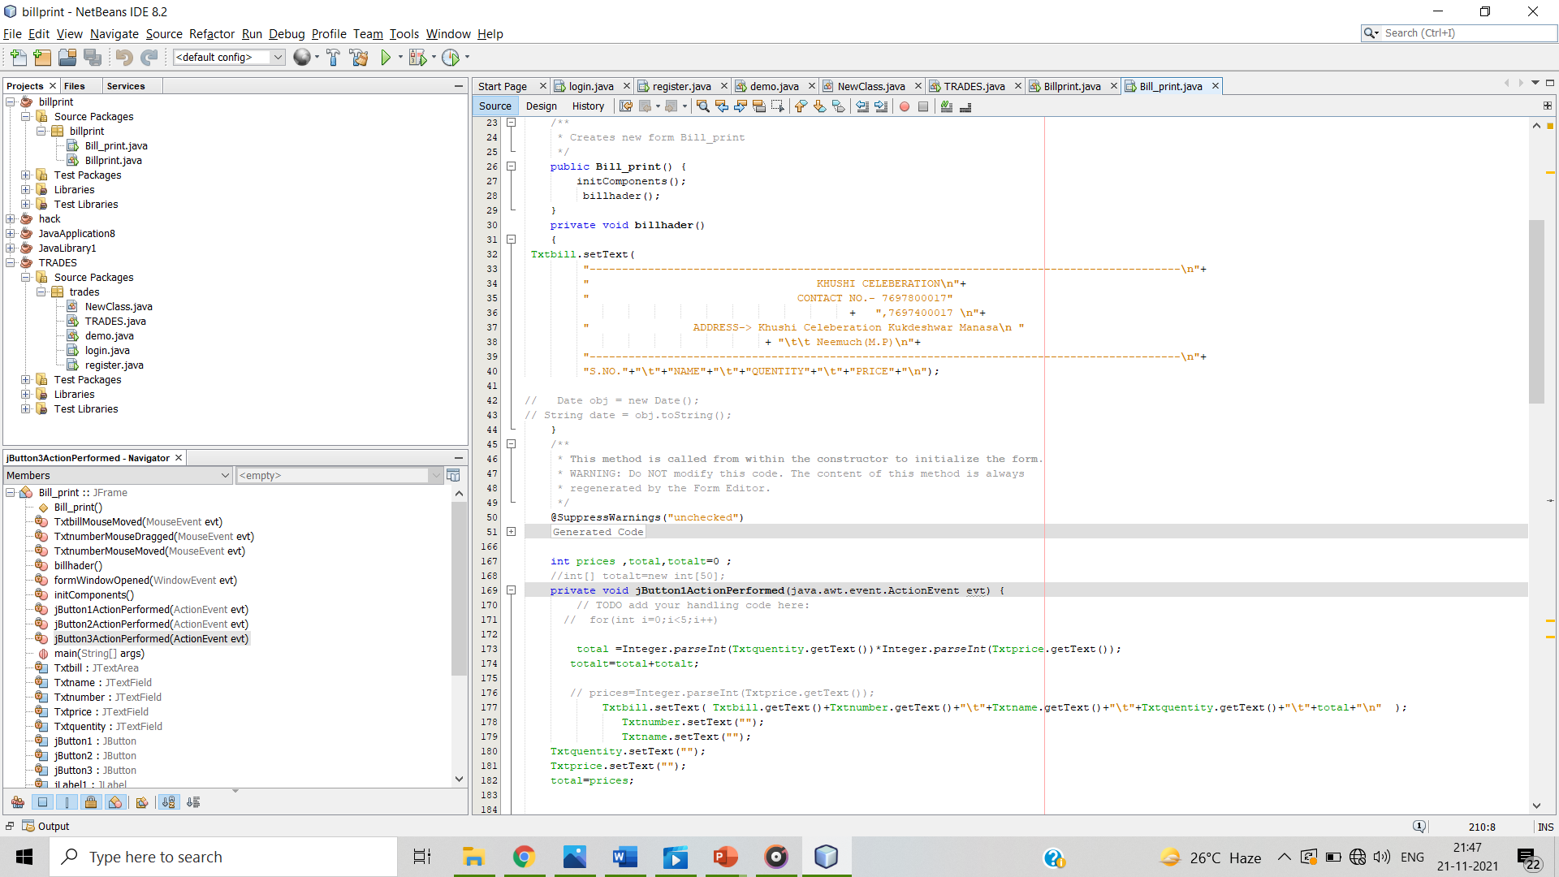
My Training Project

Slide 20
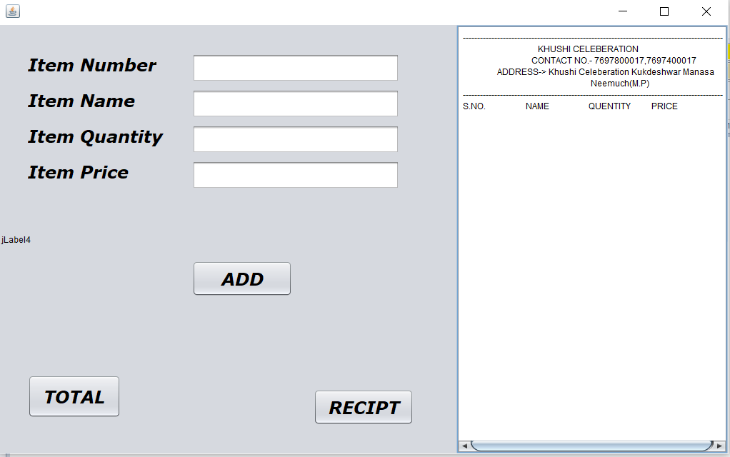
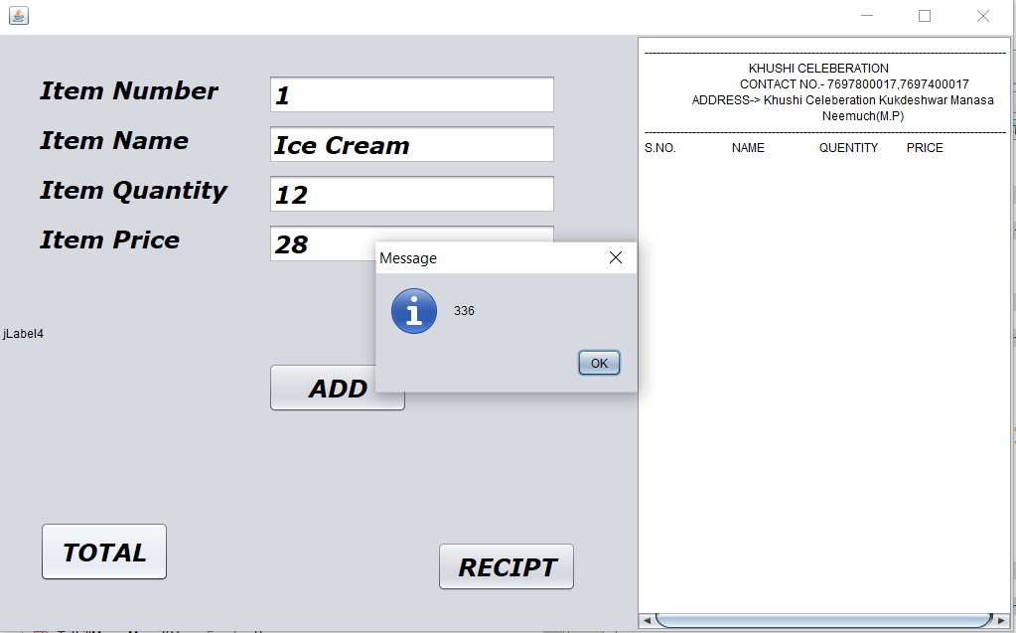

Slide 21
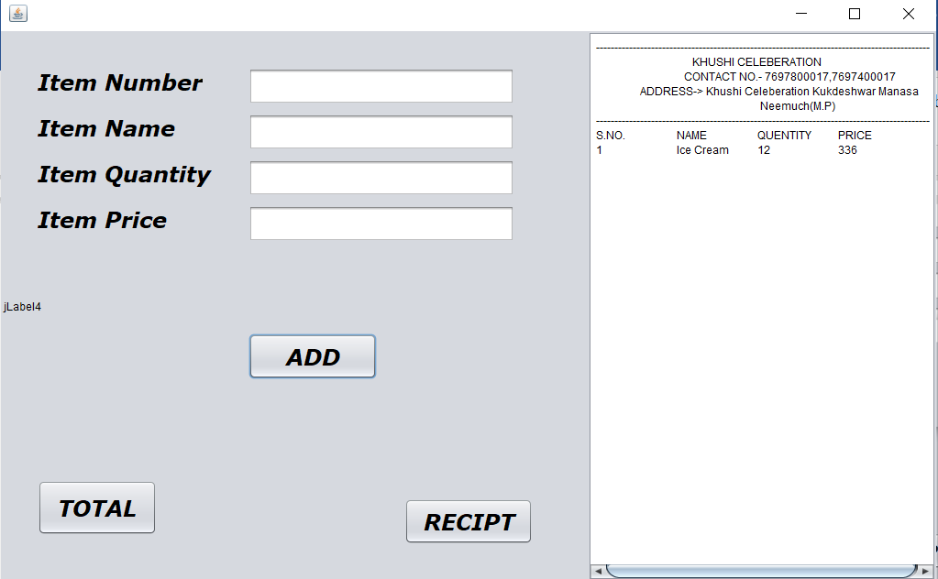

Slide 22

THANK YOU

